Slide 1
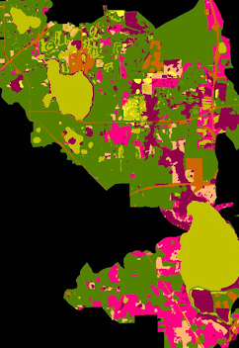
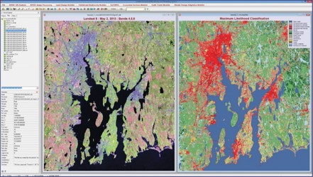
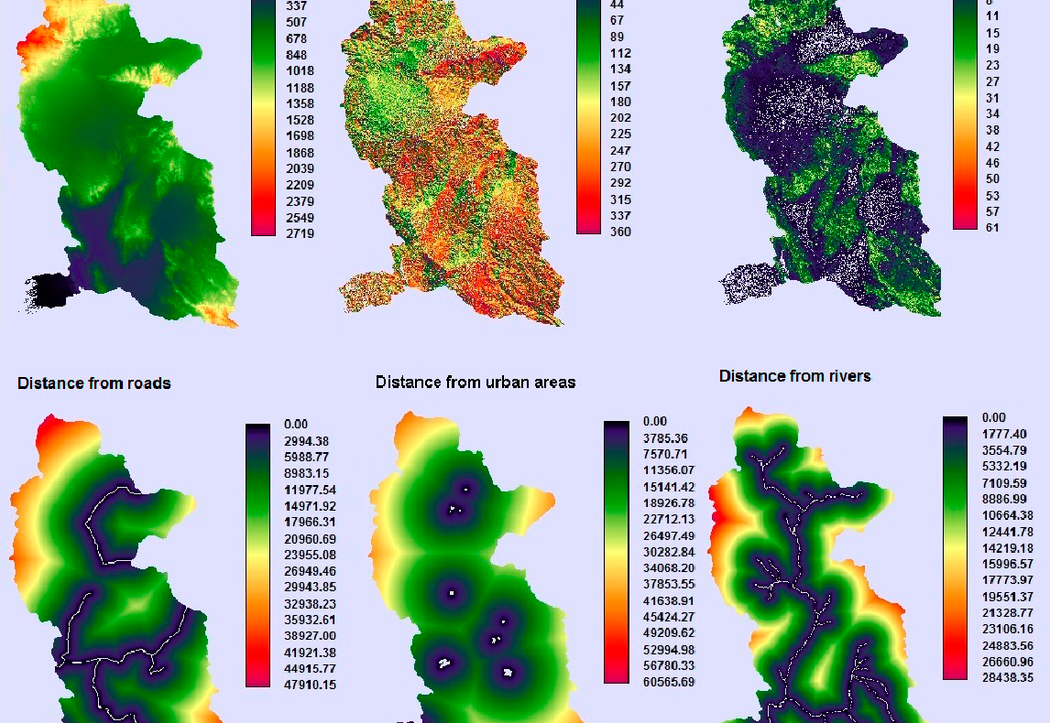
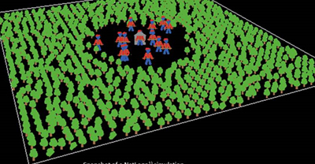
State of the Science
Land change modeling – options for future projections

Slide 2
Land change models
Used to explore the dynamics and drivers of change
Broad array of model choices
No single magic bullet
Each model has assumptions and limitations
Approaches:
Cellular models
Sector based and spatially disaggregated
Agent based
Hybrid approaches

Slide 3
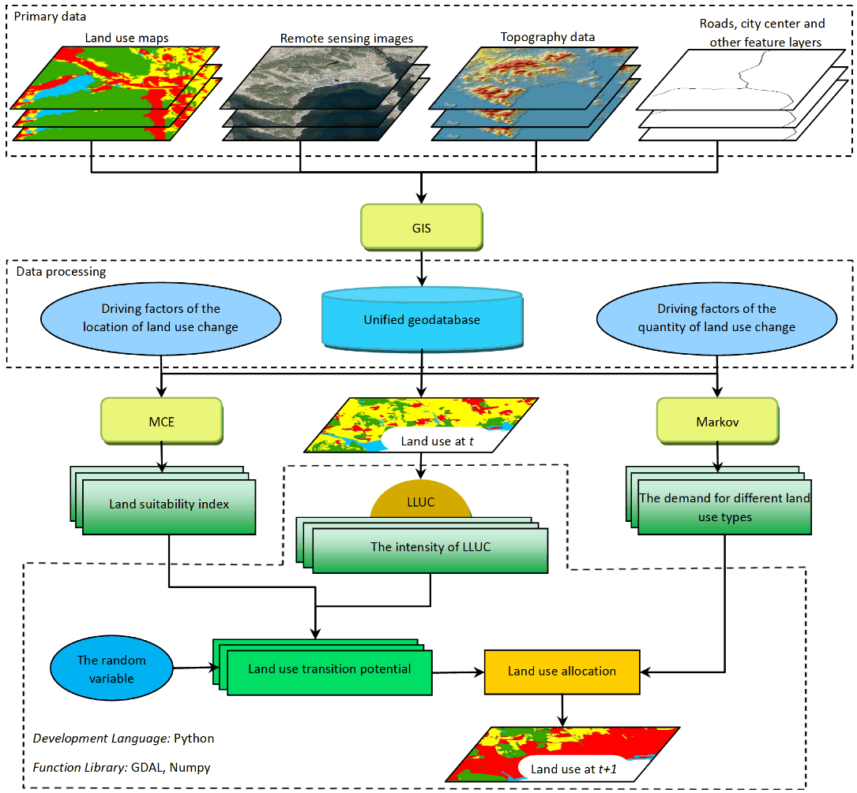
Cellular Automata Models
Most common land change model
Regular grid cells – any finite # of cells
Initial state (time t=0) is selected, and then new generation is created by advancing t by 1 according to set of hueristics
New state of each cell assigned for t=1
Typically, the update at time point is applied simultaneously to all cells and rules do not change through time.
This is now changing fast – stochastic cellular automata and asynchronous cellular automation
Notes:
CA models simulate new development in locations of high suitability, based on a weighted overlay of locally important site suitability factors (Verburg et al., 2006). Areas identified as highly suitable for new development through CA are derived from empirical analyses of observed growth patterns.

Slide 4
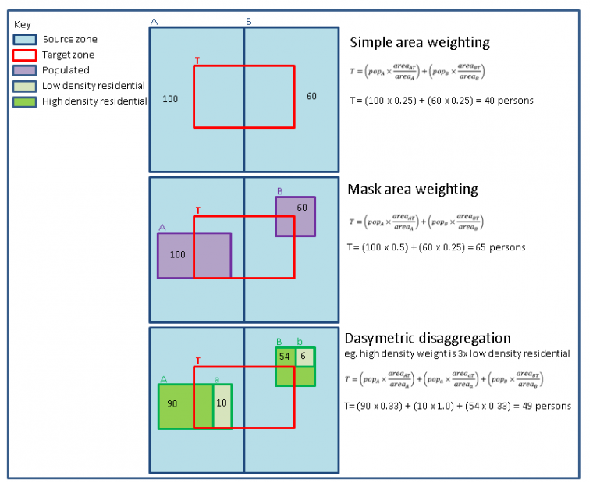
Sector based and spatially disaggregated
Data often collected or released at relatively aggregated level (e.g. census data)
Disaggregation of source data provides localized estimates and to highlight “hotspots”
Often referred to as “downscaling”
Process of taking information at course spatial scale and translating to finer
Areal interpolation techniques used, ranging from simple area weighting to dasymetric disaggregation

Slide 5
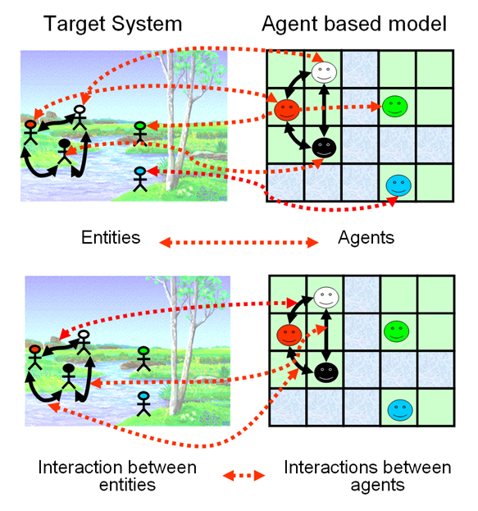
Agent based models (ABMs)
System is modeled as a collection of autonomous decision making “agents”
Agents make decisions based on a rule set
Repetitive interactions between agents are key feature
Enables exploration of dynamics beyond pure mathematical models
Agents can be capable of “evolving” in space and time
Allows unanticipated behaviors to emerge
Sophisticated ABMs incorporate neural networks, evolutionary algorithms, and other machine learning techniques.

Slide 6
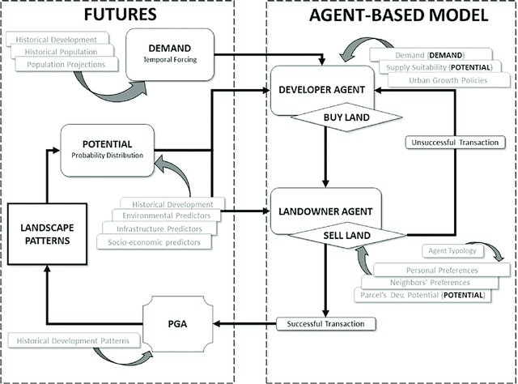
Hybrid approaches
Uses multiple different modules (cellular automata, ABM, disaggregation)
Commonly cellular and ABMs are being joined together
Novel research area in its infancy

Slide 7
Model choices and resources:
FUTURES and FUTURES ABM – NC State University
SLEUTH – UC Santa Barabara
TerraSet (Land Change Modeler) – Clark University
CLUE products – VU University, Netherlands

Slide 8
FUTURES and FUTURES ABM
FUTure Urban-Regional Environmental Simulation
Designed to address regional scale ecological environmental impacts of urbanization
Can accommodate variety of datasets w/ differing spatial extents
Language: GrassGIS/python
Difficulty: High
Cellular automate/hybrid
https://cnr.ncsu.edu/geospatial/research/futures/

Slide 9
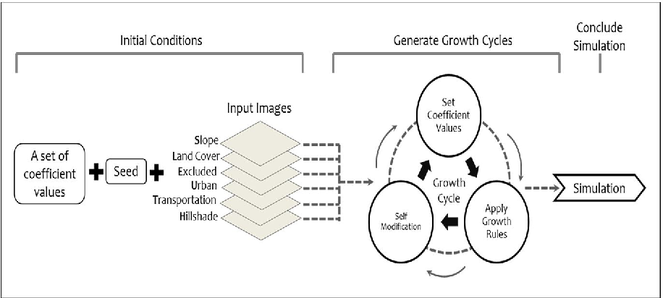
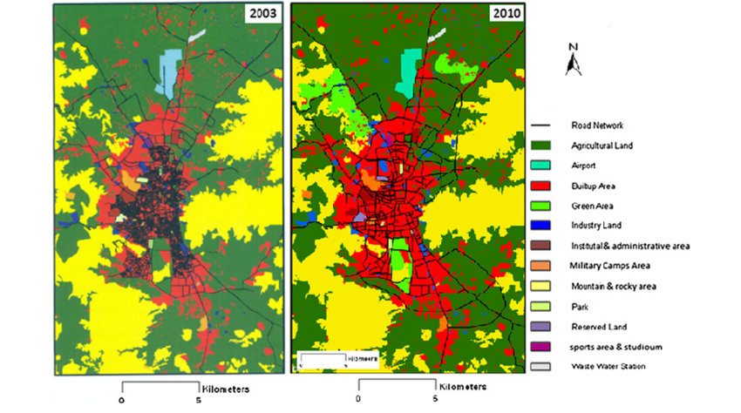
SLEUTH
Slope, Land cover, Exclusion, Urbanization, Transportation, and Hillshade.
Simulation of urban growth on a regional, continental and global scale.
Requires 5 standard datasets, with no parameterization available.
Language: C
Difficulty: Low to moderate (no C experience necessary)
Cellular automata
http://www.ncgia.ucsb.edu/projects/gig/

Slide 10
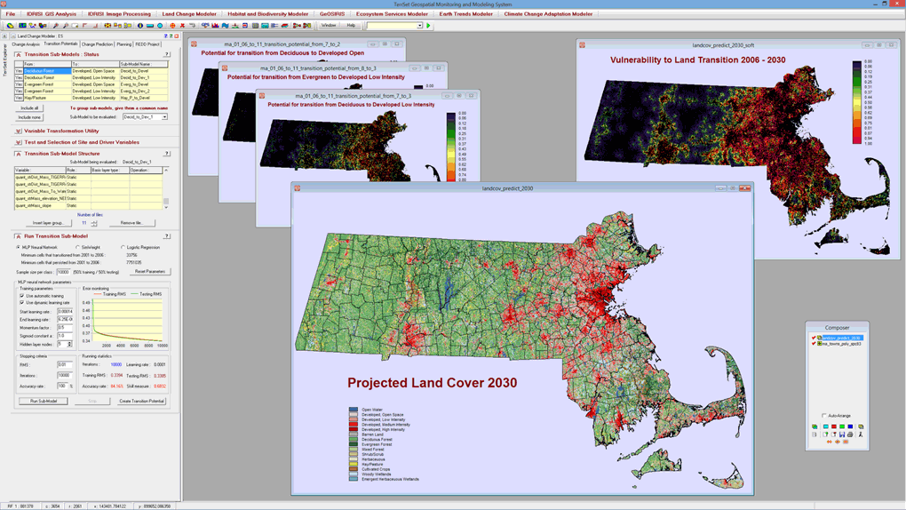
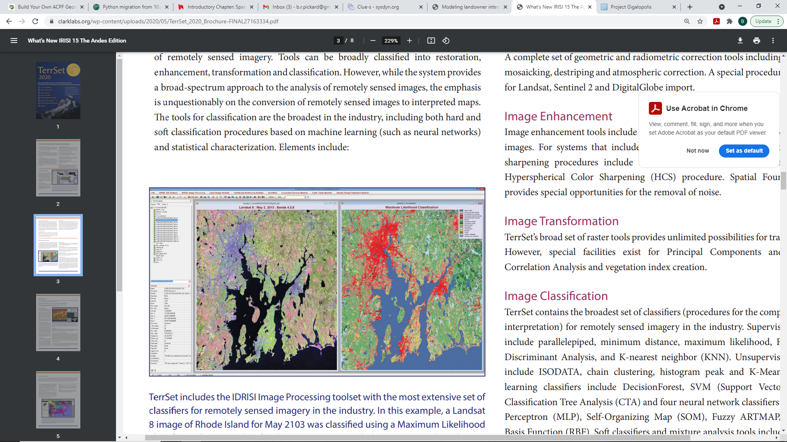
TerraSet - LCM
Integrated software system for monitoring and modeling the Earth system for sustainable development.
Land Change Modeler (LCM) uses two historical land cover maps to quickly generate graphs and maps of change.
Accommodates infinite land cover classes.
Uses Markov Chain analysis to project expected change depending on user defined scenario.
Language: own software
Difficulty: Medium
Cellular automata
https://clarklabs.org/terrset/land-change-modeler/

Slide 11
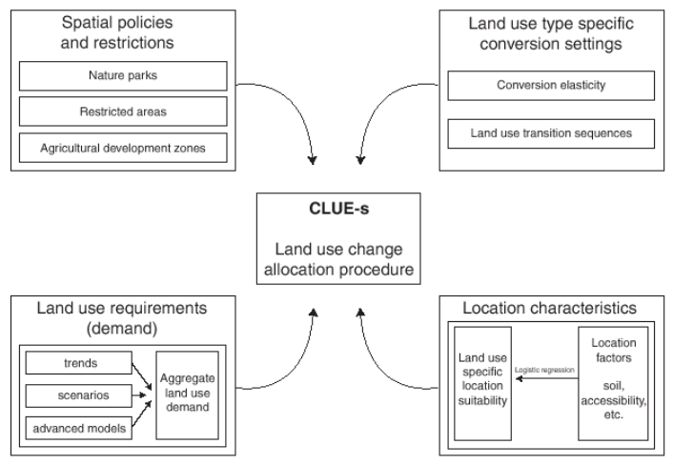
CLUE Products
Conversion of Land Use and its Effects, also CLUE-S (small extents), DynaCLUE
Two sub models
1) non-spatial land demand
2) spatial allocation
Only land change model that can handle two-way land change interactions.
Can accommodate variety of datasets w/ differing spatial extents
Language: self contained software
Difficulty: easy/medium depending on version, DynaCLUE (multi-level demand) challenging.
Cellular automata
https://www.environmentalgeography.nl/site/data-models/data/clue-model/

